Slide 1
Updated eve-BAC mutant results
3/17/2020

Slide 2
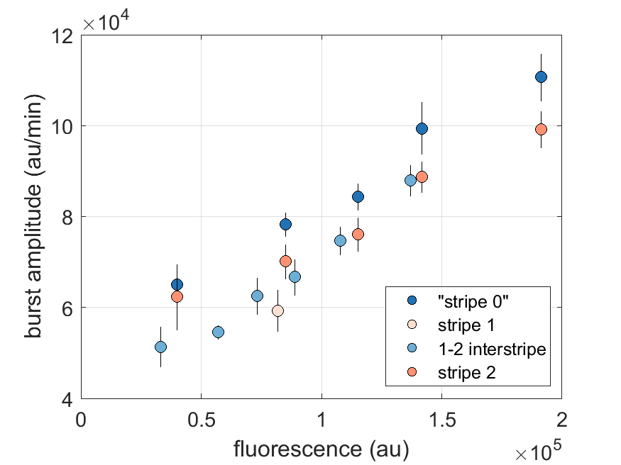
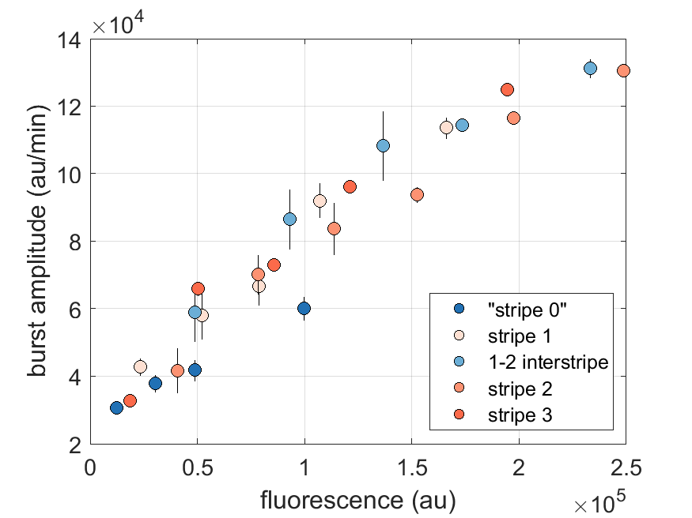
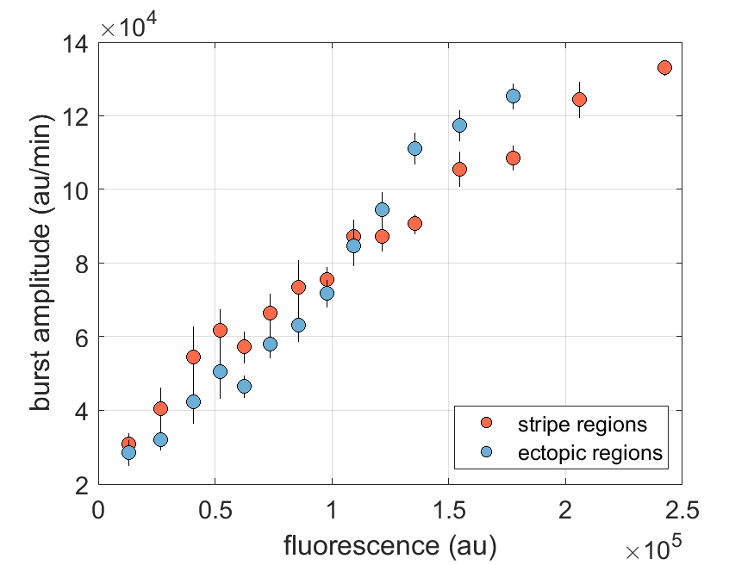
Transcription is transcription
WTS1-GtS2
NullS1-GtS2
NullS1-GtS2 (just ectopic)

Slide 3
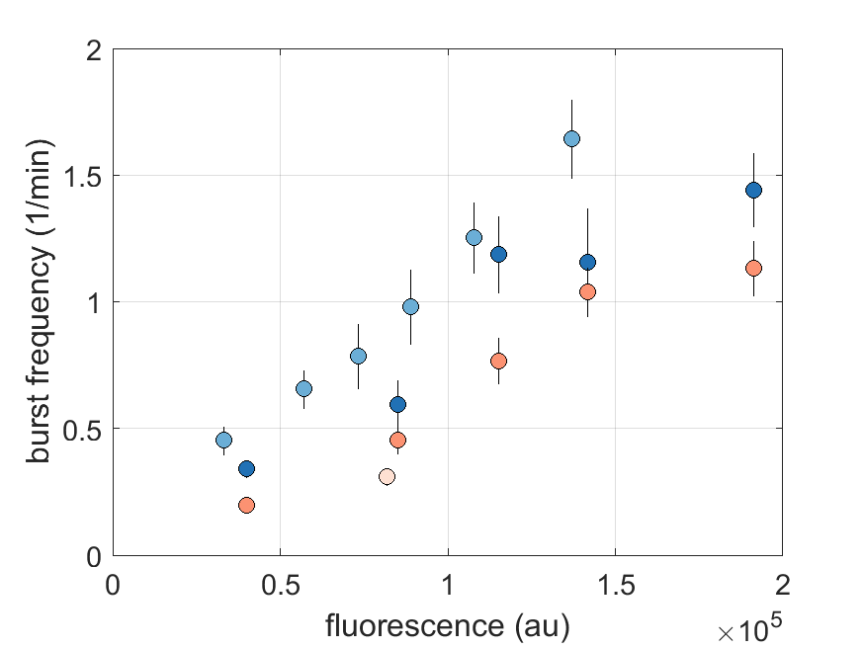
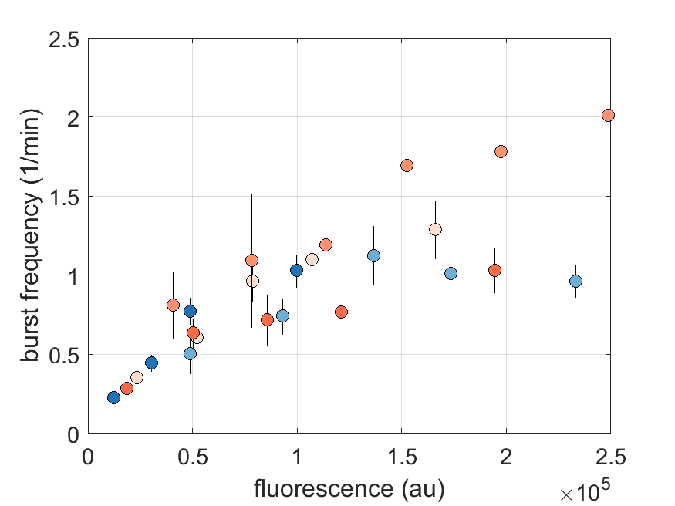
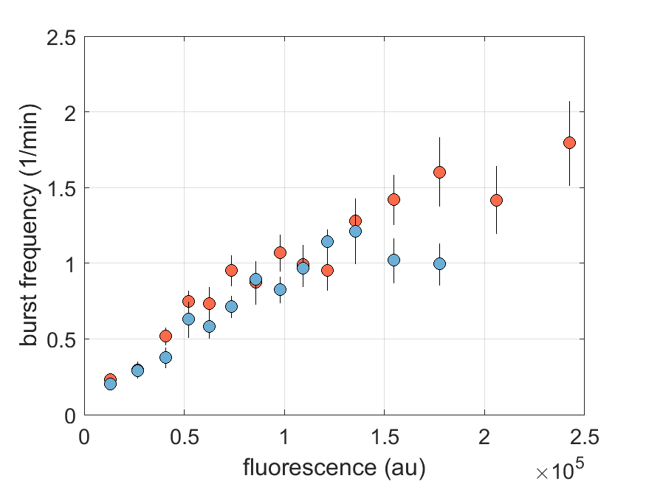
Transcription is transcription
WTS1-GtS2
NullS1-GtS2
NullS1-GtS2 (just ectopic)

Slide 4
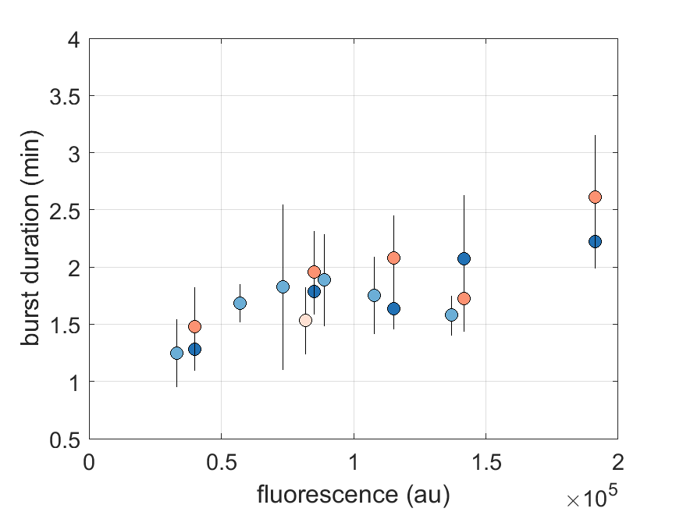
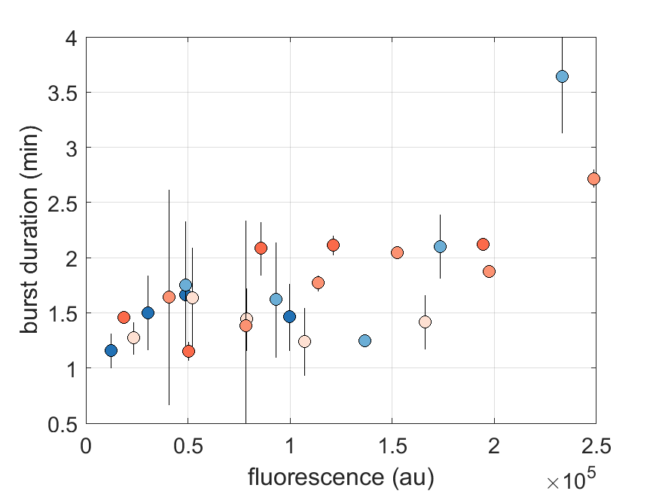
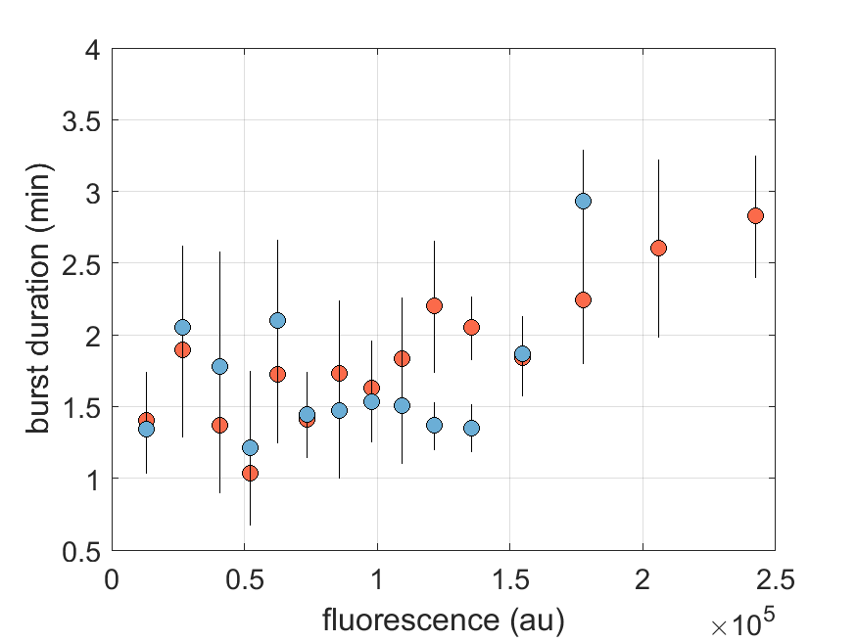
Transcription is transcription
WTS1-GtS2
NullS1-GtS2
NullS1-GtS2 (just ectopic)

